Slide 1
Ravishankar Singh
Oracle Certified Trainer

Slide 2
In order to execute a successful java program we need three parties
1) User (Person who writes java program)
2) Java Compiler (javac)
3) Java Virtual Machine (JVM)

Slide 3
Life Cycle Of a Java Program
Test.java (Java Source File)
Java Compiler (Javac)
Byte code(.class file)
Java Virtual Machine (JVM)
Output of Java Program

Slide 4
The entire JVM architecture can be divided into 3 parts
1) Class Loader Sub System
2) Runtime Data Areas (Memory areas)
3) Execution Engine

Slide 5
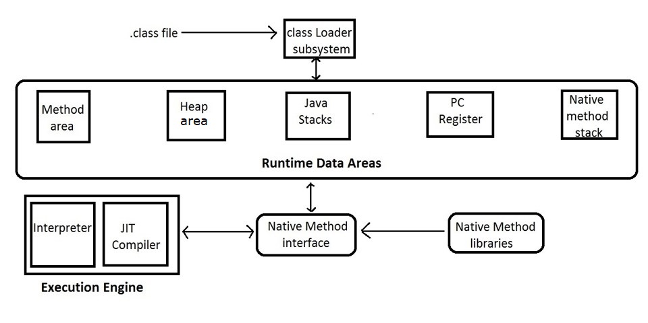
Components in JVM Architecture

Slide 6
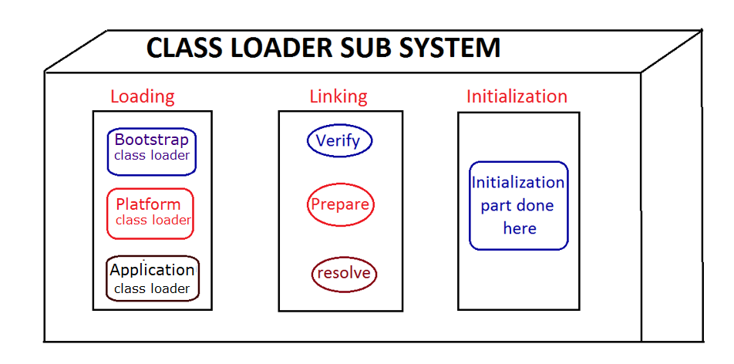
1) Class loader Sub System is used to load and execute the .class file

Slide 7
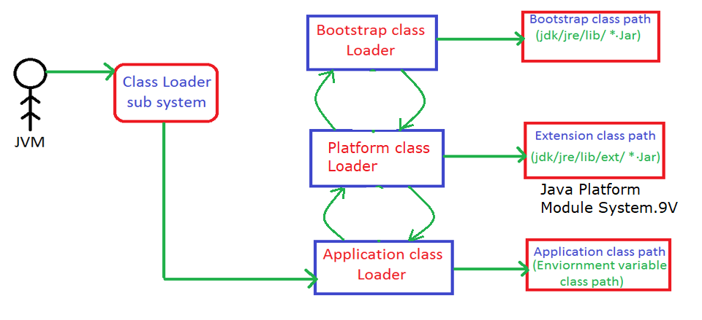
The class loader sub system follows Delegation Hierarchy Algorithm

Slide 8
2) Runtime Data Areas
Method Area (To hold Class data)
Heap Area (To hold Object data)
Stack Area (To hold Thread data)
PC Register (To hold address of current executing instructions of Methods)
Native Method Stack (To hold Native Method Stack Information )

Slide 9
3) Execution Engine
Interpreter
JIT Compiler

